Slide 1
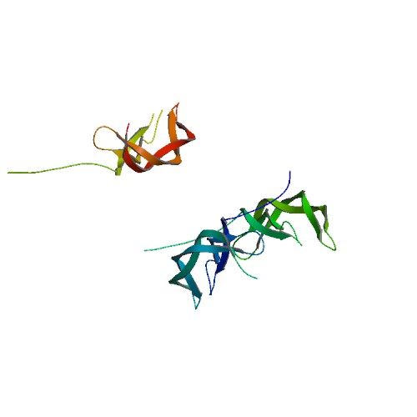
Becaplermin (approved investigational) DB00102
Category : Angiogenesis Inducing Agents
Description : Becaplermin is produced by recombinant DNA technology by insertion of the gene for the B chain of platelet derived growth factor (PDGF) into the yeast, Saccharomyces cerevisiae. Becaplermin has a molecular weight of approximately 25 KD and is a homodimer composed of two identical polypeptide chains that are bound together by disulfide bonds.
Use : For topical treatment of skin ulcers (from diabetes) in humans and other mammals.

Slide 2
Target : Platelet-derived growth factor receptor beta,Platelet-derived growth factor receptor alpha,Alpha-2-macroglobulin.
Pharmacodynamics : Used for the topical treatment of skin ulcers, Regranex has a biological activity similar to that of endogenous platelet-derived growth factor, which includes promoting the chemotactic recruitment and proliferation of cells involved in wound repair and enhancing the formation of granulation tissue.
Mechanism of action : Binds to the beta platelet-derived growth factor (PDGF) receptor, a tyrosine kinase receptor. PDGF is known to exist as a dimer, and activates its signaling pathway by a ligand induced receptor dimerization and autophosphorylation. PDGF receptors also contain many auto-phosphorylation sites, which serve to mediate binding of SH2 sites and subsequently signal corresponding pathways. There are five different isoforms of PDGF that activate through two different receptors (alpha and beta).
Sequence : SLGSLTIAEPAMIAECKTRTEVFEISRRLIDRTNANFLVWPPCVEVQRCSGCCNNRNVQCRPTQVQLRPVQVRKIEIVRKKPIFKKATVTLEDHLACKCETVAAARPVT

Slide 3
Brand name : OMJ Pharmaceutical's Regranex
Preparation : Gel: 0.01%
Storage : Becaplermin should be stored in a refrigerator at 2 C to 8 C (36 F to 46 F). It should not be frozen and should not be used after the expiration date imprinted on the tube.
Prescribed for : Becaplermin is used to treat diabetic ulcers of the lower limbs (foot, ankle and leg) along with usual ulcer care which includes the removal of dead tissue, reduction of pressure on the ulcer, and management of infection.
Dosing : The amount of becaplermin that is applied to the ulcer depends on the size of the ulcer. This can be calculated by measuring the greatest length and width of the ulcer and then applying the amount that is recommended by the directions that accompany each tube of becaplermin. The following method is recommended depending on whether the measurements are in inches or centimeters as follows:
A 15 g tube: length of ulcer x width x 0.6 = length of gel (inches) or length of ulcer x width ÷ 4 = length of gel (cm)
A 2 g tube: length of ulcer x width x 1.3 = length of gel (inches) or length of ulcer x width ÷ 2 = length of gel (cm)
To apply becaplermin gel, hands should first be thoroughly washed. The tip of the tube should not be allowed to contact the ulcer site or any other surface and thereby become contaminated. The cap on the tube should be closed tightly after each use. The calculated amount of gel should be applied once a day.
Drug interactions : There are no known important drug interactions that can occur with becaplermin.
Side effects and precautions : The most common side effect of becaplermin is a rash that can develop on the skin where it is applied. Other important side effects caused by the drug include redness of the skin called erythema, a skin ulcer with possible infection and pain at the location where the drug is applied. An increased risk of developing cancer or dying from cancer has been reported with becaplermin use. The drug should be used with caution in individuals with a history of cancer.

Slide 4
General reference : http://www.ema.europa.eu/docs/en_GB/document_library/EPAR_-_Scientific_Discussion/human/000212/WC500050140.pdf

